Slide 1


Content Strategy: Top 5 Social Buzz Trends

Slide 2


Today's agenda
Project recap
Problem
The Analytics team
Process
Insights
No. of Reactions Over Time
Count of Each Reaction Type
Aggregate Scores of Each Category
Top 5 Categories
Summary

Slide 3

Social Buzz is a fast growing technology unicorn that need to adapt quickly to it’s global scale. Accenture has begin a 3 month POC focusing on these tasks:
An audit of Social Buzz’s big data practice
Recommendations for a successful IPO
Analysis to find Social Buzz’s top 5 most popular categories of content
Project Recap

Slide 4

Problem
Over 100000 posts per day
36,500,000 pieces of content per year!
But how to capitalize on it when these so much?
Analysis to find social Buzz’s top 5 most popular categories of content.

Slide 5


Ankita Tanwar
Data Analyst
Marcus Rompton
Senior Principle
Andrew Fleming
Chief Technical Architect
The Analytics team

Slide 6
Process
1
Data Understanding
2
Data Cleaning
3
Data Modelling
4
Data Analysis
5
Uncover Insights

Slide 7

Insights
No. of Reactions Over Time
Count of Each Reaction Type
Aggregate Score of Each Category
Top 5 Categories

Slide 8
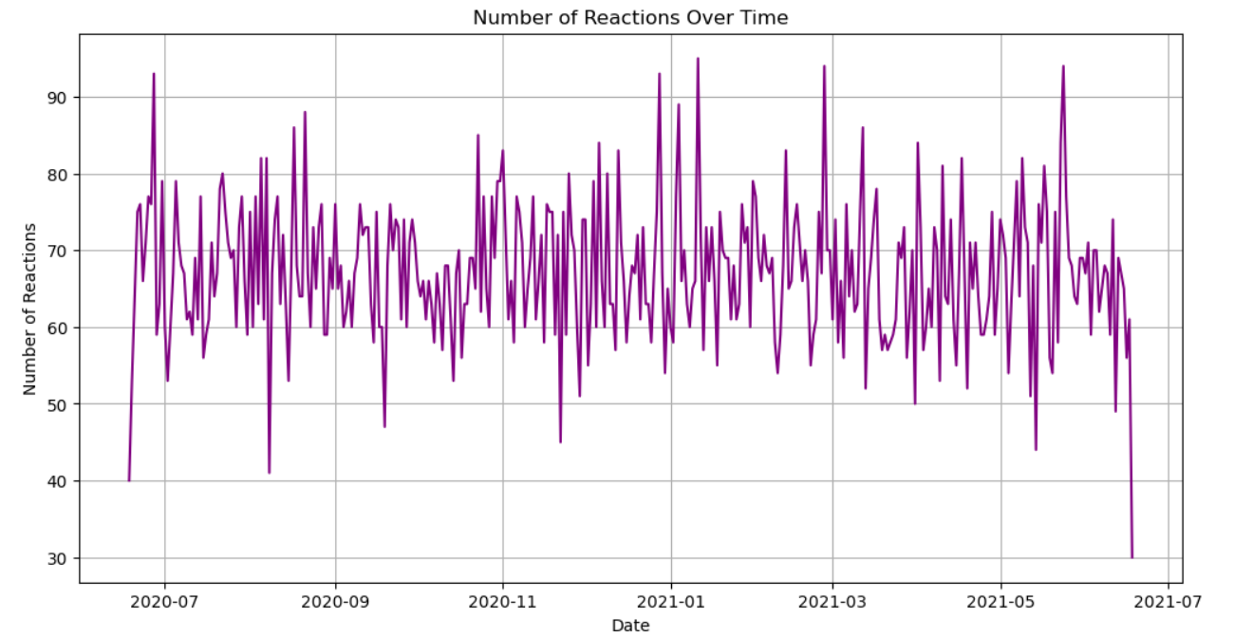
No. of Reactions Over Time

Slide 9
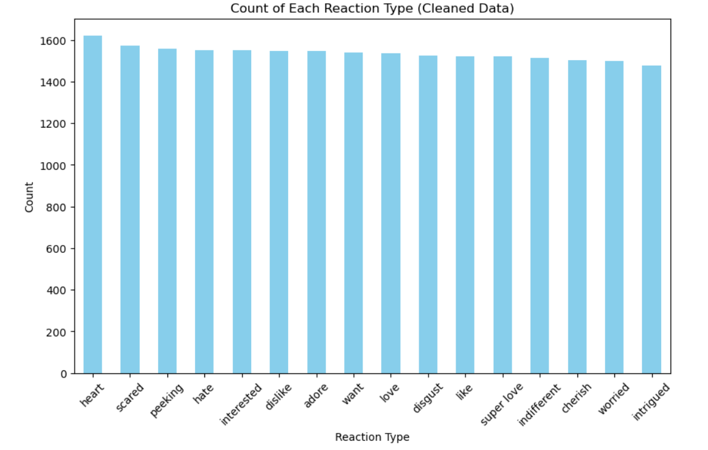
Count of Each Reaction Type

Slide 10
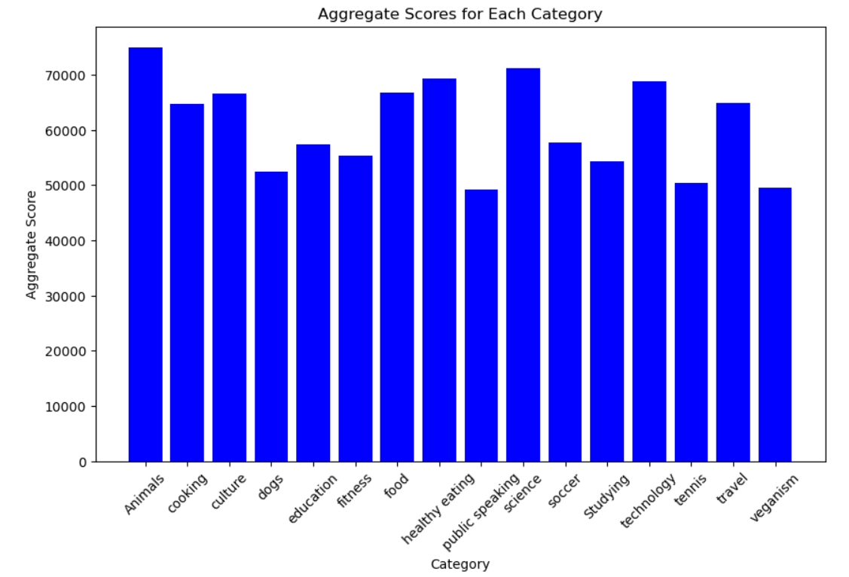
Aggregate Scores of Each Category

Slide 11
Top 5 Categories

Slide 12

In this presentation, we analyzed over 36.5 million pieces of content generated annually across social media platforms to identify the top 5 most popular content categories. Through detailed data analysis, we found the following key insights:
Top 5 Categories: The most engaging content comes from:
Entertainment (memes, viral videos, celebrity news)
Technology (AI, gadgets, software)
Health & Wellness (fitness tips, healthy recipes)
Lifestyle (fashion, travel, home decor)
Current Events (global news, politics)
Engagement Trends: Each category showed distinct engagement patterns, with videos and interactive posts being more successful in categories like Entertainment and Health & Wellness.
Growth Opportunities: Categories like Current Events and Technology hold significant growth potential in specific subtopics (e.g., regional news and AI advancements).
Actionable Insights: We recommend focusing content creation on the top categories, tailoring strategies to the preferences of key audience segments, and capitalizing on high-engagement content formats like video and interactive posts.
Summary

Slide 13
Thank you!
ANY QUESTIONS?

